Slide 1
Digital Pizzabox – Overview
Functionality
Motor positions capturing
Detector triggering
More with firmware customization
Current resource utilization: registers 6%, LUTs 13%.
Deployed at QAS, ISS, …
Encoders
Pizzabox
Servers
Turbo PMAC
Detectors
Timing system
Other triggering source

Slide 2
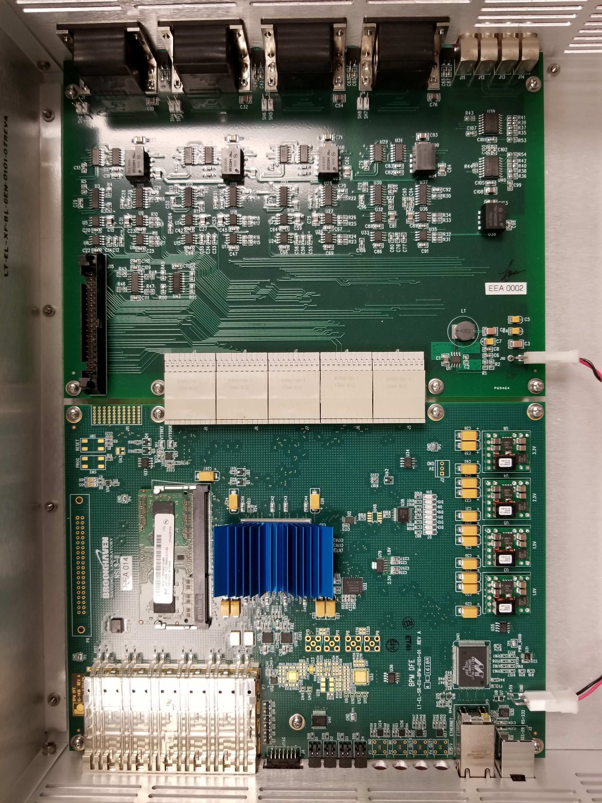
Digital Pizzabox – What’s inside
NSLS-II BPM Digital Front End (DFE) board
Virtex-6
1GB DDR3 DRAM
Encoder interface board
Interfaces
Quadrature incremental encoder
Renishaw
Delta Tau Turbo PMAC
Timing system
Timestamp (8 ns resolution)
Triggering event
Ethernet
GPIO

Slide 3
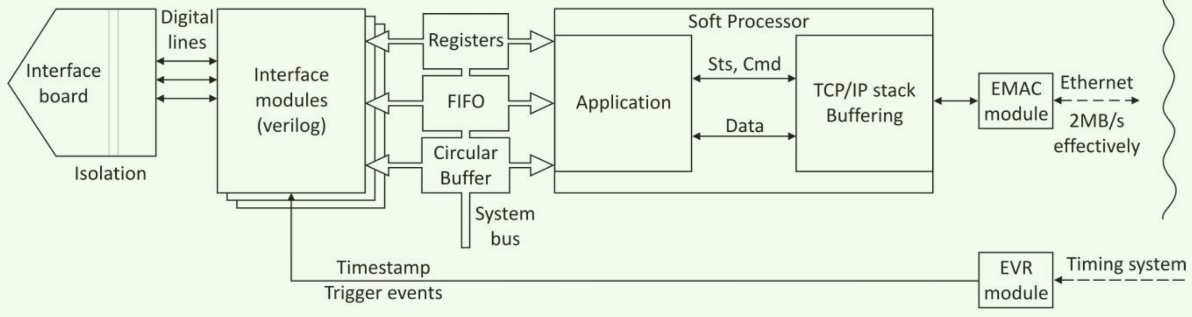
Digital Pizzabox – How it works

Slide 4
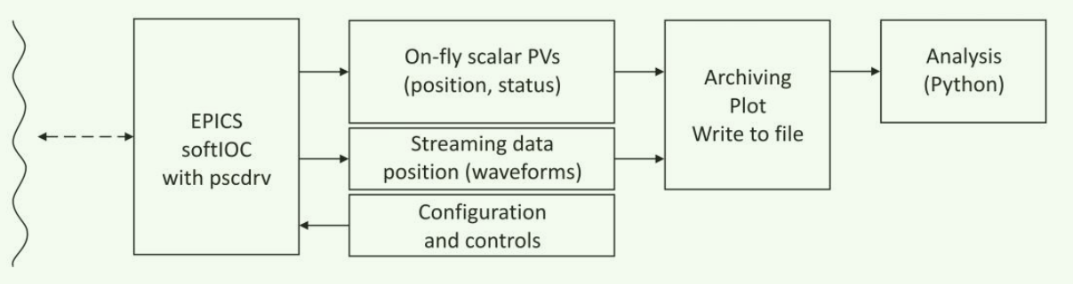
Digital Pizzabox – How to communicate
EPICS soft IOC
Available PVs
Encoder positions
Device registers
GPIO states

Slide 5
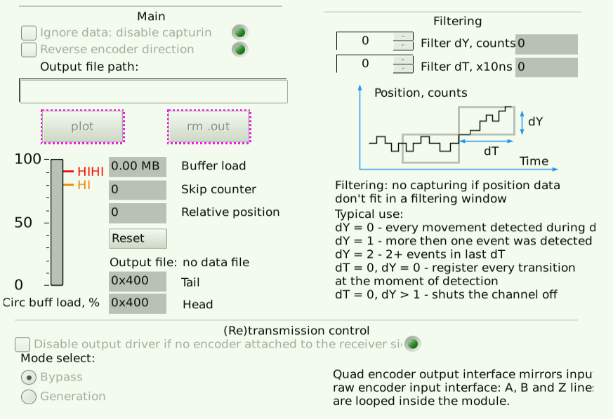
Digital Pizzabox – How to interface
Record file – save, plot
Circular buffer status
Filtering parameter setup
Mode selection

Slide 6
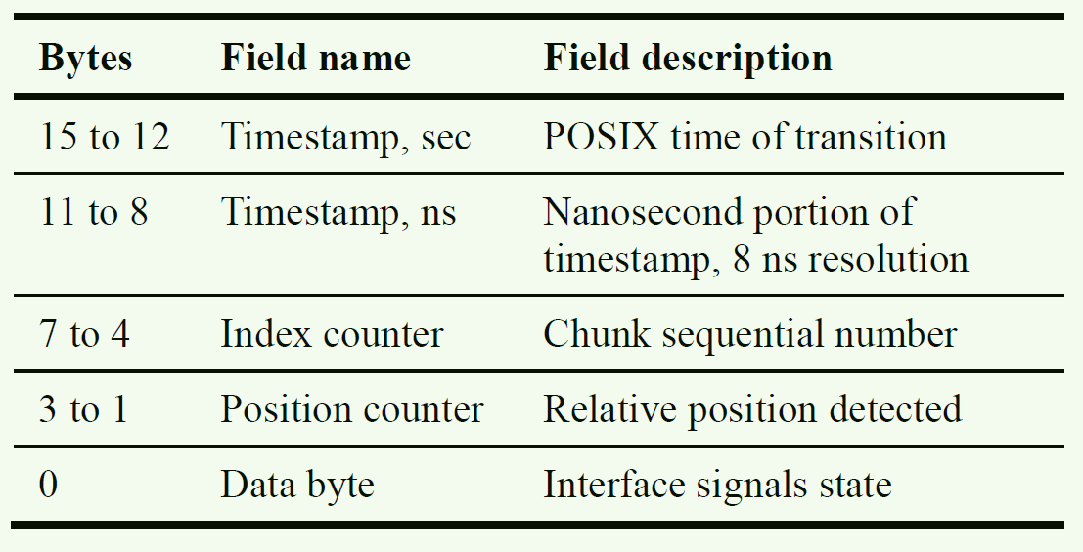
Digital Pizzabox – How well it performs
Encoder signal processor
FIFO
Circular buffer (DDR3)
Network
NPI
NPI
1GBE
800 Mb/S
800 Mb/S
2 Mb/S
Circular buffer (DDR3 memory)
256Mb per channel
Data erased if buffer overflows
Network
LWIP
Data rate in v.s. data rate out

Slide 7
Digital Pizzabox – Reference
FPGA project
Circuit (schematic/PCB) files
EPICS IOC
Ruslan Kadyrov, et el., Encoder Interface for NSLS-II Beam Line Motion Scanning Applications, ICALEPCS’15.

